Slide 1

NETA PowerPoint® Slides
to Accompany
Prepared by
Katharine Ferguson,
Seneca College

Slide 2
Short Workplace Messages and Digital Media
Chapter 7

Slide 3
Unit 3 Employability Skills
Fundamental Skills
Communicate
Manage Information
Think and Solve Problems
Personal Management Skills
Demonstrate Positive Attitudes and Behaviours
Be Responsible
Be Adaptable
Learn Continuously
Teamwork Skills
Work With Others
Participate in Projects and Tasks

Slide 4
Short Workplace Messages and Digital Media
E-mail standards
and practices
Workplace messaging
and texting
Podcasts and
wikis
Business blogs
Business use of
social networking

Slide 5
E-mail: Love It or Hate It
E-mails
Are not always done well and can waste time
Leave a dangerous “paper” trail on servers within and outside organizations
Notes:
E-mail has become the standard form of communication within organizations and the most common business communication channel. E-mails perform critical tasks including informing employees, giving directions, outlining procedures, requesting data, supplying responses, and confirming decisions.
Canadians read 48 percent of e-mail on mobile devices, 25 percent on their desktop, and 27 percent via webmail.

Slide 6
Why People Complain About E-mail
Often are poorly written and confusing
Merely serve to confirm receipt or thanks, resulting in time wastage
Have helped to eliminate the distinction between work life and home life because of 24/7 availability and need for immediate response
Can be used in a court of law against an individual or company
Notes:
Put nothing in an e-mail message that you wouldn’t post on your office door. Know your organization’s e-mail policy before sending personal messages. As many as a quarter of employers have fired an employee for an e-mail violation.

Slide 7
Knowing When E-mail Is Appropriate
Short, informal messages that request information and respond to inquiries
Messages to multiple receivers
Messages that must be saved (archived)
As a cover document when sending longer attachments
Not a good substitute for face to face or phone calls

Slide 8
Composing Professional E-mails
Draft a compelling subject line to make the receiver want to open the e-mail. Adjust the subject line if the topic changes.
Include a greeting to set the message tone.
Begin with a strong opening.
Organize the body for readability and tone.
Close effectively with an action statement with due dates and requests using a friendly note.
Include a signature block.

Slide 9
Formatting an E-mail Message
1
2
3
Prewriting
Drafting
Revising
Analyze
Anticipate
Adapt
Research
Organize
Compose
Edit
Proofread
Evaluate
Notes:
E-mails generally contain guide words, a greeting, a body, a complimentary closing, and a signature block.
Guide words are Date, To, From, and Subject, and the order depends on whether you are sending or receiving the message.
On the subject line, identify the subject of the message. Be sure to include enough information to be clear and compelling.
A friendly greeting provides a visual cue that marks the beginning of the message.
In the body cover just one topic and ensure that capitalization and punctuation are correct. Try to keep the message under three screens long.
The complimentary close is optional but should be friendly. A signature block which includes full contact information is important.
E-mail messages are permanent and searchable and can be forwarded to anyone. Take care to follow best practices when using e-mail.

Slide 10
Time-Management Strategies
Check your e-mail at set times (e.g., first thing in the morning and again after lunch or at 4 p.m.).
Avoid distractions by turning off your audio and visual alerts.
Use the “two-minute rule.” Read and respond to a message within two minutes.
Add longer messages to your to-do list or schedule them on your calendar.
Notes:
For longer messages, be sure to send a quick note telling the sender when you plan to respond.

Slide 11
Replying Efficiently With Down-Editing
Insert your responses to parts of the received message.
Include only the parts of the received message to which you are responding.
Delete the sender’s message headings, signature, and all unnecessary parts.
Use a different colour for your down-edits.

Slide 12
Writing Interoffice Memos
Memos are necessary for important internal messages that
Are too long for e-mail
Require a permanent record
Demand formality
Inform employees who may not have access to e-mail
Memos deliver changes in procedures, office instructions, and reports.

Slide 13
Writing Interoffice Memos
Memos
Are necessary for complex internal messages too long for e-mail and delivered as attachments to e-mail
Function better as permanent records because e-mails can be difficult to locate and may contain confusing replies
Identify the date, sender, receiver, and subject when sent as an attachment to e-mail

Slide 14
Similarities in Memos and E-mails
Both carry non-sensitive information that may be organized directly with the main idea first.
Both have guide words calling for subject line, a dateline, and the identification of the sender and receiver.
Both should be organized with headings, bulleted lists, and enumerated items when possible.

Slide 15
Similarities in Memos and E-mails
Both generally close with
Action information, dates, or deadlines
A summary of the message
A closing thought to avoid sounding abrupt

Slide 16
Professional E-mail and Memos
Subject line
Summarize the central idea.
Include labels if appropriate.
Avoid empty or dangerous words.
Opening
State the purpose for writing.
Highlight questions.
Supply information directly.

Slide 17
Professional E-mail and Memos
Body
Explain details.
Enhance readability.
Apply document design.
Be cautious.
Closing
Request action.
Provide a goodwill statement or a closing thought.
Avoid cliché endings.

Slide 18
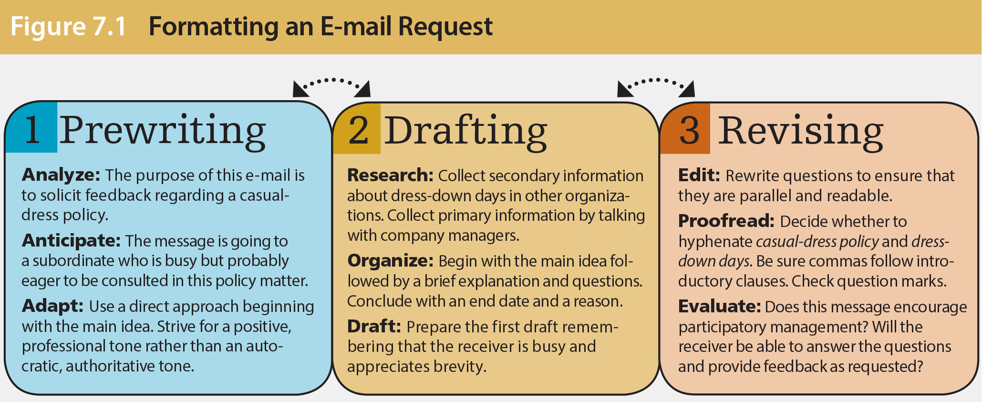
Formatting an E-mail Message

Slide 19
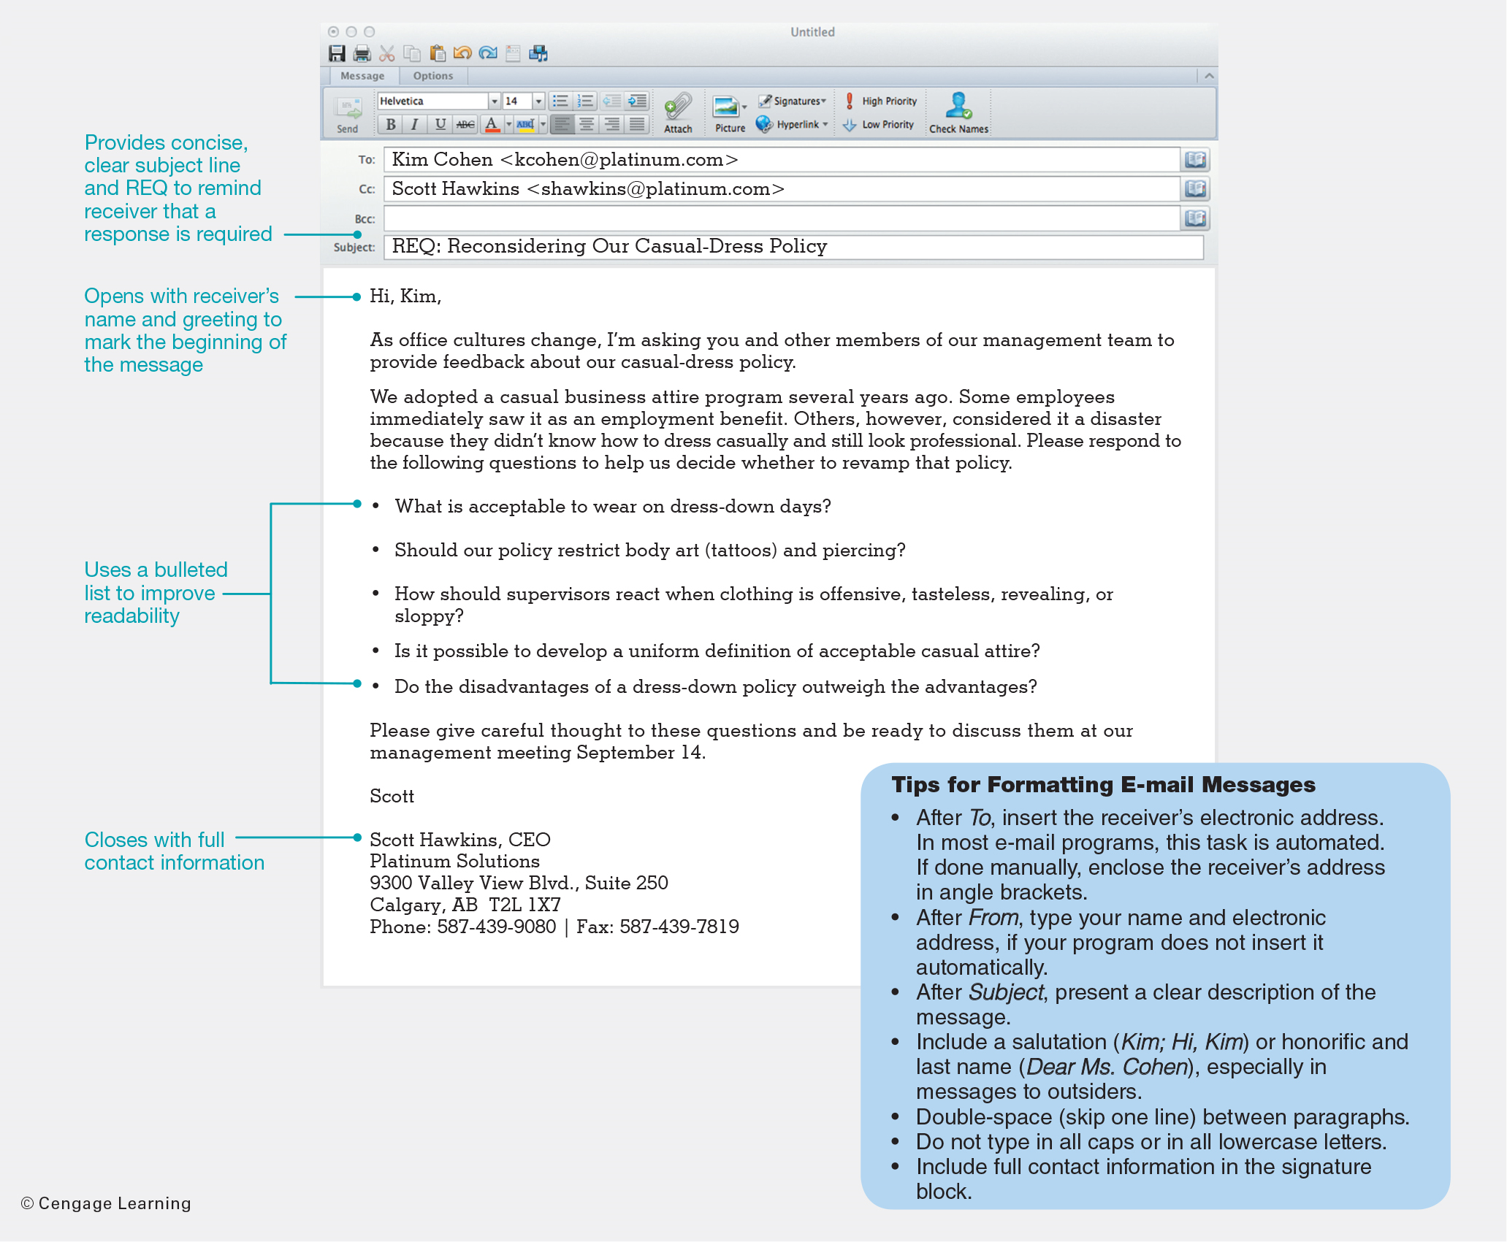
Formatting an E-mail Message

Slide 20
Tips for Formatting E-mail Messages
After To, insert the receiver’s electronic address. In most e-mail programs, this task is automated. If done manually, enclose the receiver’s address in angle brackets.
After From, type your name and electronic address, if your program does not insert it automatically.
After Subject, present a clear description of the message.

Slide 21
Tips for Formatting E-mail Messages
Include a salutation (Kim; Hi, Kim) or honorific and last name (Dear Ms. Cohen) especially in messages to outsiders.
Double-space (skip one line) between paragraphs.
Do not type in all caps or in all lowercase letters.
Include full contact information in the signature block.

Slide 22
Smart E-mail Practices
Getting Started
Don’t write if a richer channel might work better.
Send only content you would want published.
Write a compelling subject line, possibly with names and dates: Jake: Can You Present at January 10 Staff Meeting?

Slide 23
Smart E-mail Practices
Replying
Scan all e-mails, especially those from the same person. Answer within 24 hours or say when you will.
Change the subject line if the topic changes. Check the threaded messages below yours.
Practise down-editing.
Start with the main idea.
Use headings and lists.

Slide 24
Smart E-mail Practices
Observing Etiquette
Obtain permission before forwarding.
Soften the tone by including a friendly opening and closing.
Resist humour and sarcasm.
Avoid writing in all caps, which is like SHOUTING.

Slide 25
Smart E-mail Practices
Closing Effectively
End with due dates, next steps, or a friendly remark.
Add your full contact information including social media addresses.
Edit your text for readability. Proofread for typos or unwanted auto-corrections.
Double-check before hitting Send.

Slide 26
Workplace Messaging and Texting
Instant messaging (IM)
Enables two or more individuals to use the Internet or intranet to “chat” in real time by exchanging brief texts
Text messaging
Means for exchanging brief messages in real time using smart devices
Notes:
Interesting statistics: as of 2016 over 30 million Canadians subscribed to wireless services. Of these users, 73 percent own smartphones, ranking Canadians as “the 4th heaviest mobile data users in the world.”
Start a discussion with students: how many of them IM or text? Why do they use IM and texting?

Slide 27
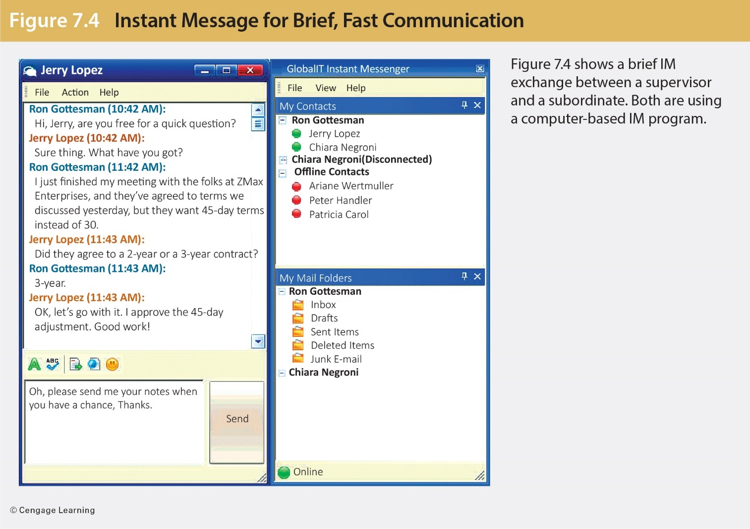
Instant Message for Brief, Fast Communication

Slide 28
Impact of IM and Texting Technology
IM and Text Messaging
They are convenient alternatives to the telephone.
There are 3.2 million IM accounts worldwide.
Some 67 percent of business professionals text and instant message.
IM use in Canada is 10 percent higher than in the United States.

Slide 29
Benefits of IM and Texting
They provide real-time communication with colleagues anywhere in the world.
They are low-cost substitutes for voice calls, delivering a message between mobile phone users quietly and discreetly.
Users know right away whether a message was delivered; this avoids phone tag.
Coworkers can locate each other online (“presence functionality”).

Slide 30
Risks of IM and Texting
IM could be a work distraction.
Companies fear that employees will reveal privileged company information and records.
The employer must ensure employees abide by governing legislation.
Large corporations are protecting themselves by taking instant messaging behind a firewall where they log and archive traffic.

Slide 31
Liability Burden
Workers’ improper use of mobile devices on company business can expose the organization to staggering legal liability.
Acts of employee negligence can cause companies to be found liable for the harm caused.
Employers could be found liable if employees must use phones while driving and an accident occurs.

Slide 32
Security and Legal Requirements
Companies worry about phishing, viruses, malware, and spim.
All electronic records, including e-mail, can become evidence in lawsuits.
Businesses are forced to track and store messaging conversations (IM and texting).
IM and texting have been implicated in inappropriate uses, including bullying and sexting.
Notes:
Phishing involves fraudulent schemes, and spim is like spam.

Slide 33
Best Practices for Instant Messaging and Texting
Adhere to your organization’s IM and texting policies.
Don’t use texting or IM to disclose sensitive information.
Steer clear of harassment and discriminatory content.
Be vigilant about appropriateness of photos, videos, and so on.

Slide 34
Best Practices for Instant Messaging and Texting
Don’t say anything that would damage your reputation or that of your organization.
Don’t text while driving.
Organize your contact lists to separate business contacts from family and friends.
Avoid unnecessary chitchat—know when to say goodbye.

Slide 35
Best Practices for Instant Messaging and Texting
Keep your presence status up to date so that people trying to reach you don’t waste time.
Make yourself unavailable when you need to meet a deadline.
Beware of jargon, slang, and abbreviations, which may be confusing and appear unprofessional.
Use good grammar and proper spelling.

Slide 36
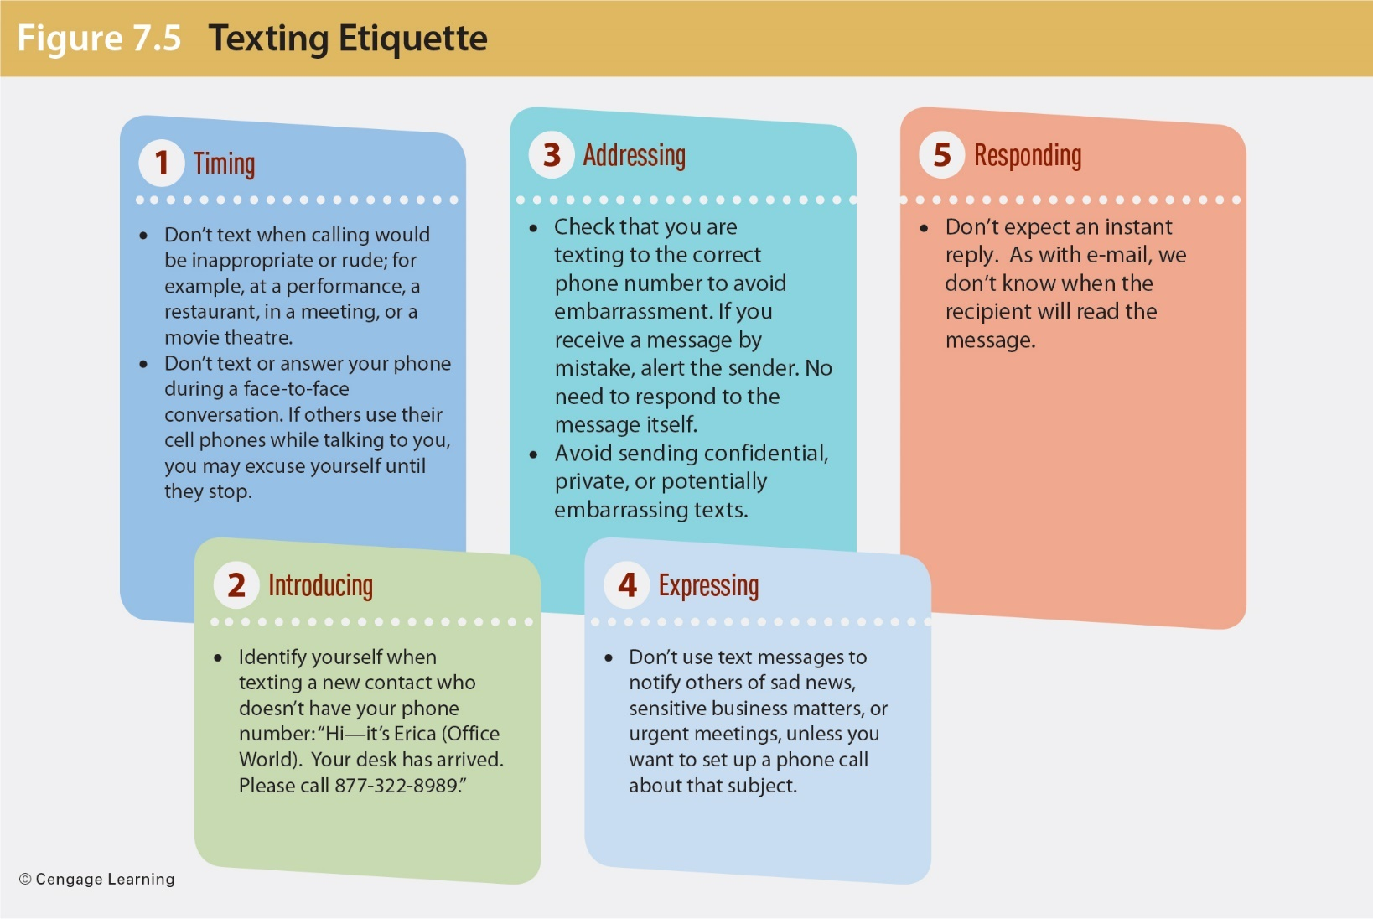
Text Messaging and Business Etiquette

Slide 37
Making Podcasts and Wikis Work for Business
Businesses often fear the wrath of disgruntled employees and customers.
Business often curry favour of influential opinion leaders, the so-called influencers.
Internet users can bypass gatekeepers who filter content.
Fact checking often falls by the wayside; buzz may become more important than truth.

Slide 38
Business Podcasts or Webcasts
Podcasts can be used
To send audio and video messages that do not require a live presence
Webcasts allow users
To create Web content
To interact with businesses and each other
To review products, self-publish, or blog
Notes:
Internet users can bypass gatekeepers who filter content in the traditional print and visual media. Hence, even extreme views often reach audiences of thousands or even millions. The dangers are obvious. Fact checking often falls by the wayside, buzz may become more important than truth, and a single keystroke can make or destroy a reputation.
Businesses have embraced podcasting for sending audio and video messages that do not require a live presence.

Slide 39
Business Podcasts or Webcasts
Common in news and education
Can be downloaded to a computer, smartphone, or MP3 player
Can broadcast repetitive information requiring no interaction; can replace teleconferencing
Can be featured on media websites and company portals
Can include short commercial segments and links to YouTube and Vimeo

Slide 40
Collaborating With Wikis
Allow multiple users collectively to create, access, and modify documents (think Wikipedia)
Capitalize on crowdsourcing
Eliminate the problem of version confusion
Are used by companies to store internal data on an intranet (private network)
Enhance the reputation of expert contributors
Notes:
Crowdsourcing is the practice of tapping into the combined knowledge of a large community to solve problems and complete assignments.

Slide 41
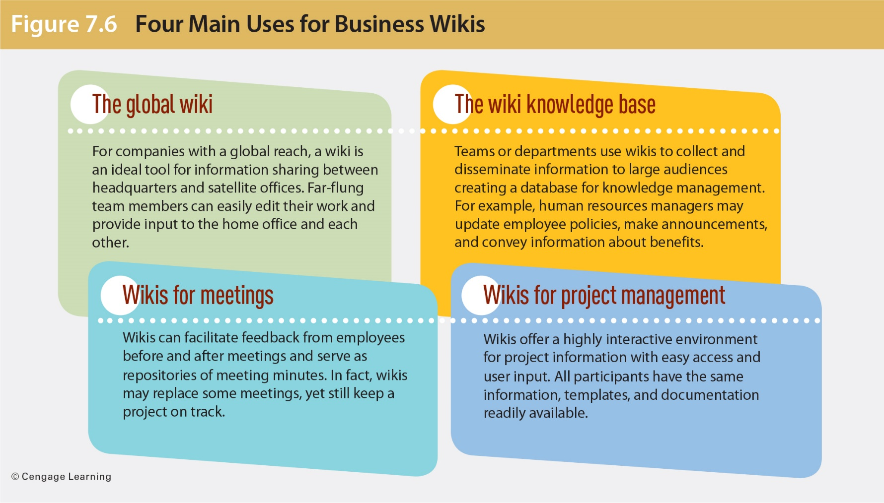
Four Main Uses for Business Wikis

Slide 42
Blogging for Business
Blogs are website with journal entries usually written by one person.
Blogs have the potential to reach a far-flung, vast audience.
Businesses keep customers and employees informed and interact with them.
Blogs can invite spontaneous consumer feedback faster and more cheaply than conventional research.
The social approach yields cultural benefit through employee engagement.
Notes:
Organizations use blogs to communicate internally with employees and externally with clients.

Slide 43
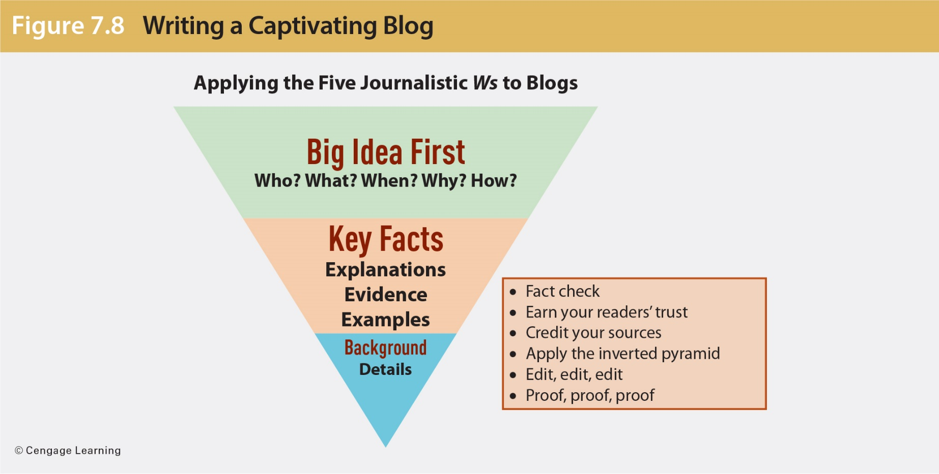
Writing a Captivating Blog

Slide 44
How Companies Use Blogs
Public relations
Customer relations
Crisis communication
Market research and viral marketing
Online communities
Internal communications
Notes:
Provide up-to-date company information to the press and the public. A company blog is a natural forum for late-breaking news, especially when disaster strikes. Business bloggers can address rumours and combat misinformation.
Because most blogs invite feedback, they can be invaluable sources of opinion from customers and industry experts. The term viral marketing refers to the rapid spread of messages online, much like infectious diseases that pass from person to person. Viral messages must be unexpected and elicit an emotional response. Viral marketing refers to the rapid spread of messages online.
Company blogs can attract a devoted community of participants who want to keep informed about company events, product updates, and other news.
Blogs can be used to keep virtual teams on track and share updates on the road.

Slide 45
Blog Best Practices: Eight Tips
Craft a catchy but concise title.
Ace the opening paragraph.
Provide details in the body.
Consider visuals.
Include calls to action.
Edit and proofread.
Respond to posts respectfully.
Learn from the best.

Slide 46
Social Networking Sites
Tapping into social networking means
Adopting the Facebook model as many staff already are comfortable with it
Connecting far-flung workers by enabling connections
Crowdsourcing customers by inviting them to input at the product-design stage
Notes:
About 83 percent of millennials regularly socialize and chat online. The number of social media users 65 and older has more than tripled in five years to 35 percent.

Slide 47
Potential Risks of Social Networking for Businesses
Causing potential losses in productivity
Compromising trade secrets
Attracting the wrath of huge Internet audiences
Facing embarrassment over inappropriate and damaging employee posts

Slide 48
Using Social Networking Sites and Keeping Your Job
Exercise caution: privacy is a myth.
Sensitive information should not be shared lightly, least of all inappropriate photographs.
You could jeopardize professional relationships by refusing “friend” requests or “unfriending.”

Slide 49
Dos and Don’ts of Using Electronic Media Professionally
Do
Learn your company’s rules.
Avoid sending personal e-mail, instant messages, or texts from work.
Separate work and personal data.
Be careful when blogging, tweeting, or posting on social networking sites.
Keep sensitive information private.

Slide 50
Do’s and Don’ts of Using Electronic Media Professionally
Don’t
Don’t spread rumours, gossip, or negative defamatory comments.
Don’t download or share cartoons, video clips, photos, or art.
Don’t open attachments sent by e-mail.
Don’t download free software or utilities to company machines.
Don’t store your music or photos on a company machine (or server), and don’t stream video.
Don’t share files, and avoid file-sharing services.

Slide 51
Summary of Learning Objectives
Understand e-mail and the professional standards for its usage, structure, and format.
Explain workplace instant messaging and texting, as well as their liabilities and best practices.
Identify professional applications of podcasts and wikis, and describe guidelines for their use.

Slide 52
Summary of Learning Objectives
Describe how businesses use blogs to connect with internal and external audiences, and list best practices for professional blogging.
Define business uses of social networking.

